Slide 1

Employee Management System
A Java-Based Centralized Employee Information System.
Centralized access to employee data for HR and management.

Slide 2
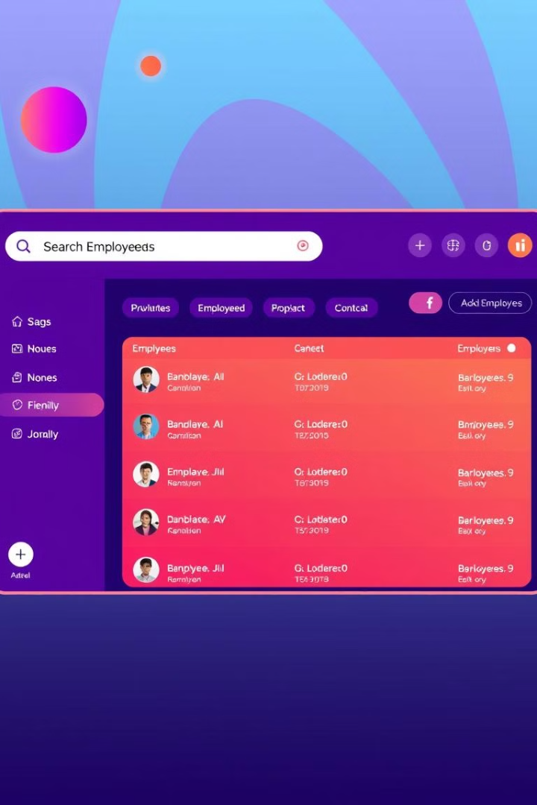
EMS: Introduction
Efficient Management
Centralized Access
Software application to manage employee records efficiently
Provides centralized access to employee data for HR and management
CRUD Operations
Allows CRUD operations on employee records

Slide 3





EMS: Objectives
Systematic Data
Store and manage employee data systematically
Easy Interface
Provide an easy-to-use interface
Real time details modifications
Ensure details modification If needed
Improve Efficiency
Reduce paperwork and improve efficiency

Slide 4
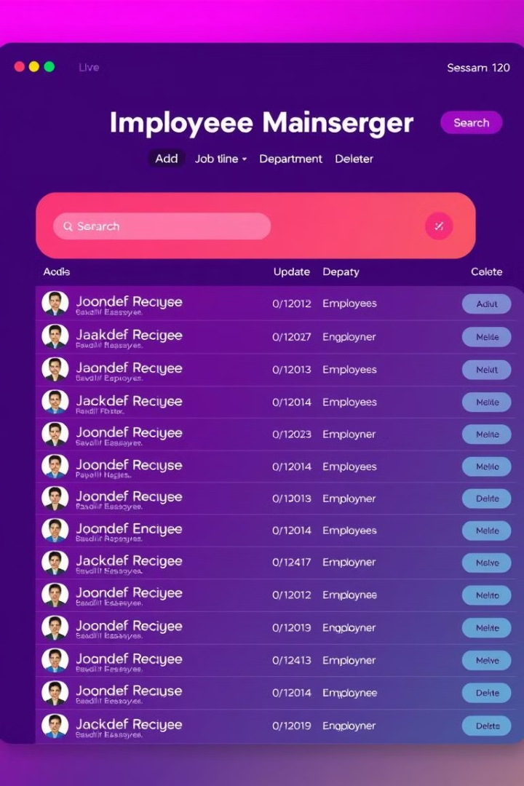




EMS: Features
Add Employees
Search Employees
Update Employees
Delete Employees
Secure login for admin and HR personnel

Slide 5
Technologies Used
Backend
Frontend
Database
Frameworks
Java (core)
Java Swing
MySQL
JDBC

Slide 6
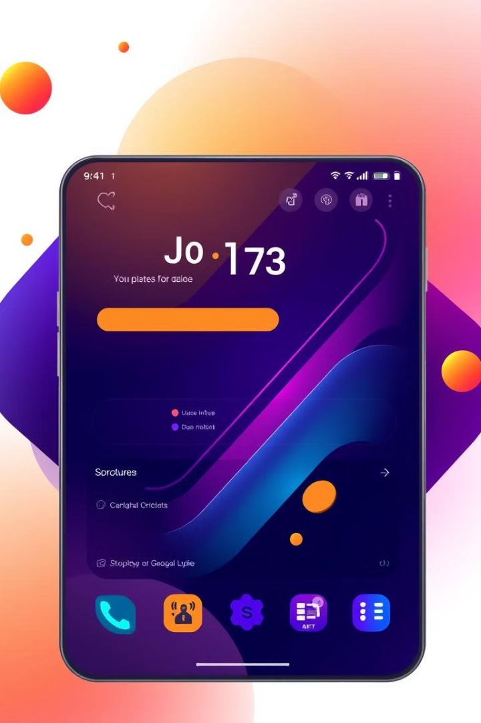
Frontend Design
Java Swing
AWT
JLabel, JButton, JFrame, ImageIcon for building GUI
Handling UI components and events
Swing Layout Managers
Organize components efficiently

Slide 7
System Architecture
User Interface
Business Logic
Database Layer
Security Layer
Java Swing-based GUI
Java and Spring Boot handle operations
MySQL/MongoDB stores employee records
Authentication & authorization

Slide 8
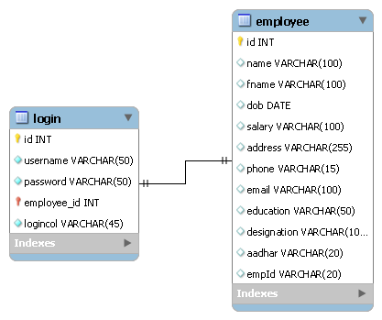
ER DIAGRAM OF EMS
DESIGNED USING MySQL WORKBENCH

Slide 9
PROJECT MODULES
MODULE 1 – LOGIN MODULE ( HR LOGIN)
MODULE 2 - EMPLOYEE MANAGEMENT MODULE ( ADD , VIEW , UPFDATE , DELETE)
MODULE 3 - DATABASE INTEGRATION MODULE ( CONNECTION OF MYSQL THROUGH JDBC)
MODULE 4 – UI MODULE ( USING THE LOGICS OF JAVA SWING )

Slide 10
Workflow
HR logs in to the system
1
2
Dashboard appears to add employee details
HR manages employee details
3
4
Changes stored securely (Update)
HR able to delete employee details
if employee leaves company
5

Slide 11
EMS: Benefits
Improved Efficiency
Paperless System
Reduces Errors
Efficient data management
Eliminates paperwork
Increases accuracy
Secure Access
Saves Time
Prevents unauthorized modifications
Enhances productivity

Slide 12





Future Enhancements
Role-Based Access
Control for different user ( HR & Employees)
Application for leave
Direct application for leaves
Attendance Tracking
Attendance can be managed of employees
Cloud Storage
Remote access

